Slide 1

The movie industry and the influential factors of IMDb movie ratings Mafalda Fragoso Data Analytics Bootcamp 27/03/2020

Slide 2


Table of contents
Goals of the project
Methodology
Main findings

Slide 3

Goals of the project
Research purpose
Exploratory analysis on the movie industry (2019)
Understand the influential factors of IMDd movie ratings:
Is the movie rating variable correlated with the duration of the movie, genre of the movie, number of votes and revenue?

Slide 4


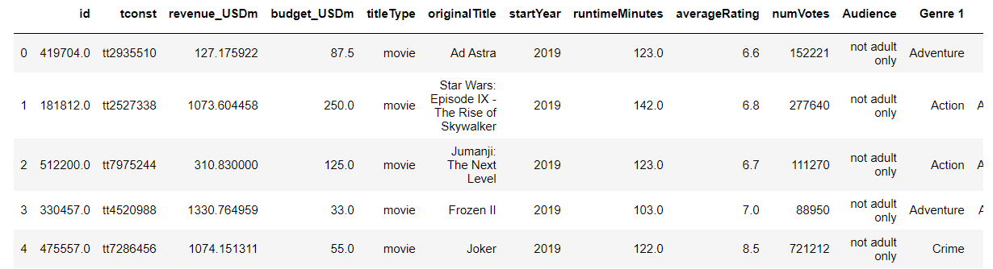
Methodology
1
Data gathering
IMDb » open datasets
The Movie Database » API
Data cleaning
Joined several tables from the IMDb open datasets with the information needed for the study
Joined the final IMDb dataset with the data gathered from the API of The Movie Database (revenue and budget variables)
Data cleaning included checking for missing values, number of duplicates, low variance and data types
Sample of 1640 movies after cleaning the data
1
2

Slide 5
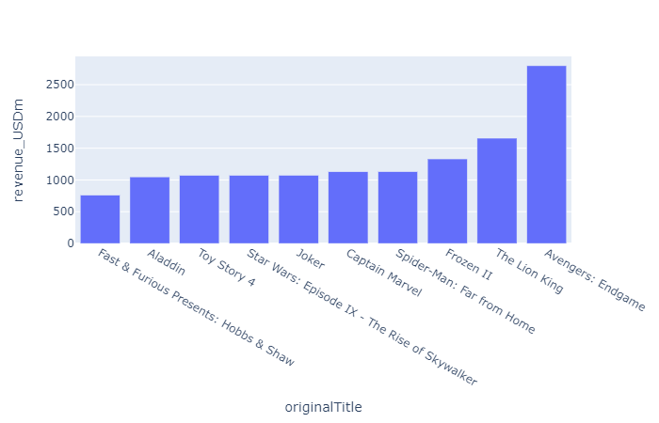
Main findings
The top movies released in 2019 based on revenue
(revenue in UDS millions - Cumulative Worldwide Gross)
IMDb rating
Revenue
8,4
6,9
7,5
7,0
7,0
7,8
6,8
8,5
6,9
6,5

Slide 6
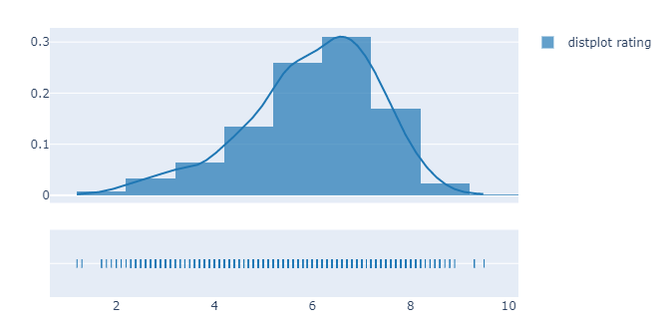
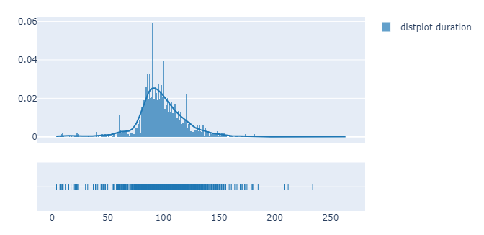
Main findings
Rating distribution
The average rating variable follows a normal distribution with a mean of 5,97
(rating scale from 1 to 10)
Duration of the movie distribution
The duration of the movie variable follows a normal distribution with a mean of 98 minutes

Slide 7
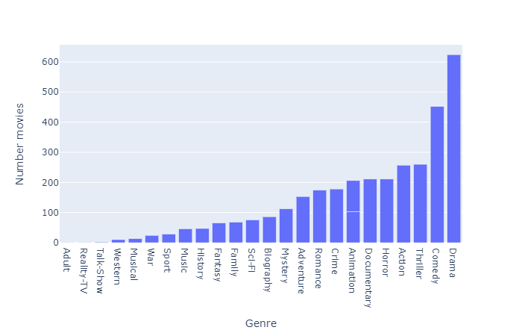
Main findings
The most representative genres in my sample are Drama, Comedy, Thriller and Action
(note: each movie can have until 3 genres classification)

Slide 8
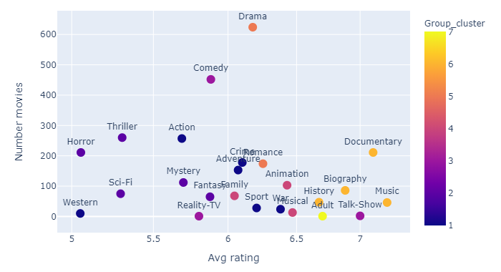
Main findings
Distribution of average rating vs number of movies per gender
There are less movies classified as technical/informative (documentary, Biography, History) but they are more likely to have higher ratings
Movies in the cluster of action, horror, sci.fi are more likely to have lower ratings

Slide 9
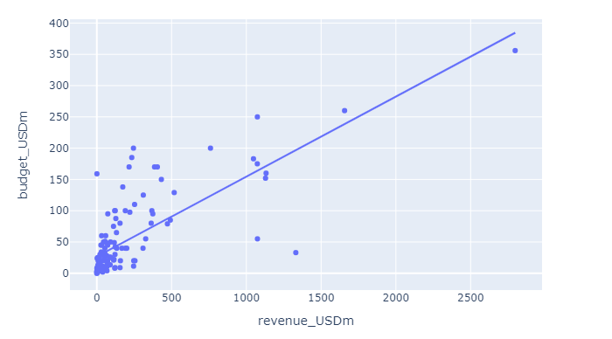
Main findings
Strong positive linear relationship between revenue and budget
(correlation coefficient 0.76)
More investment results in more payback

Slide 10
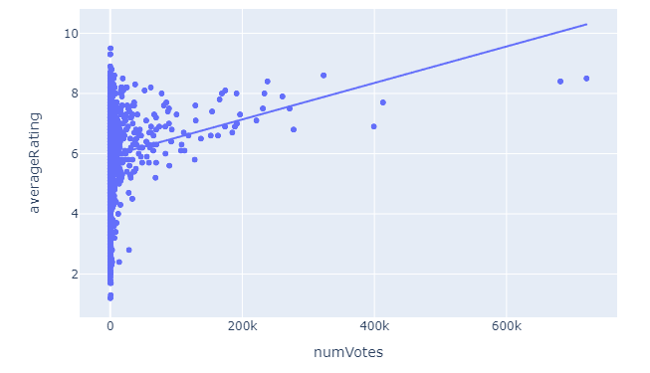
Main findings
No relationship found between average rating and number of votes
(correlation coefficient 0.17)

Slide 11
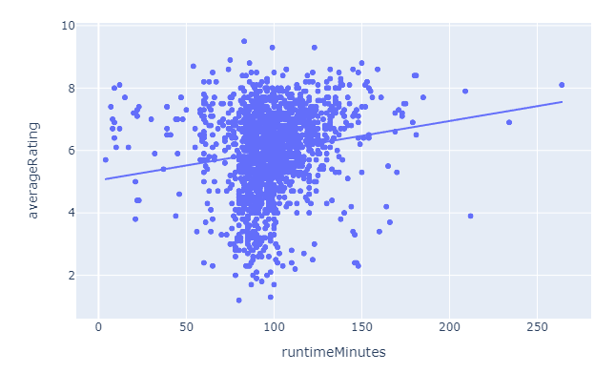
Main findings
No relationship found between average rating and duration of the movie
(correlation coefficient 0.16)

Slide 12
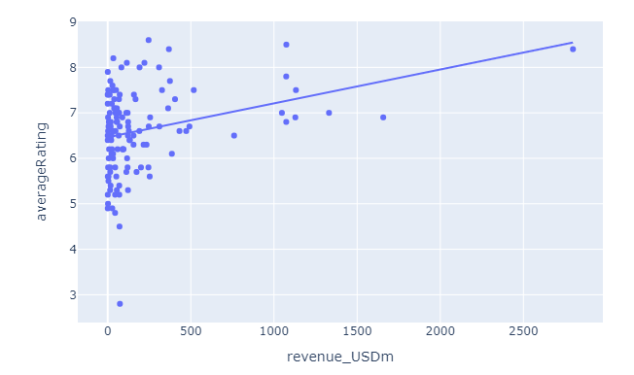
Main findings
No relationship found between average rating and revenue of the movie
(correlation coefficient 0.3)
Higher rating doesn’t necessarily correlate with higher profits for a movie

Slide 13


Conclusions
The movie rating variable is not correlated with the duration of the movie, number of votes and revenue
Technical/informative type of movies (documentary, Biography, History) are more likely to have higher ratings while movies in the cluster of action, horror, sci.fi are more likely to have lower ratings
Strong positive linear relationship between revenue and budget meaning that more investment results in more payback

Slide 14
Thank you. Mafalda Fragoso Data Analytics Bootcamp 27/03/2020

Slide 15
Appendix

Slide 16
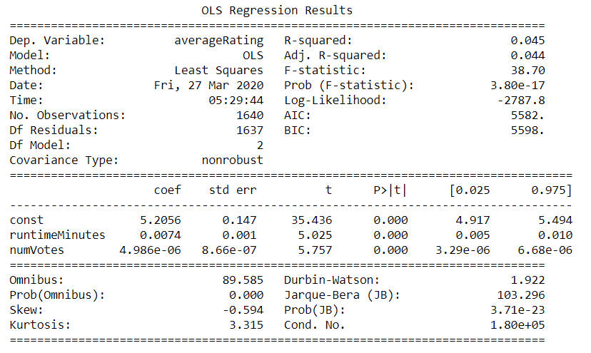
OLS Regression Results

Slide 17
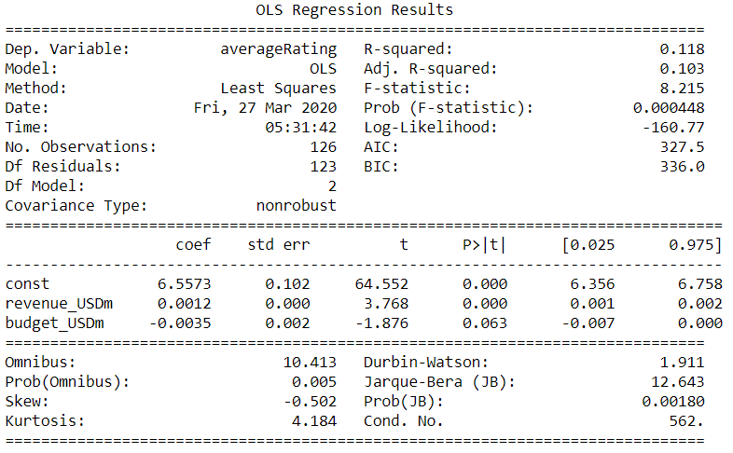
OLS Regression Results

Slide 18
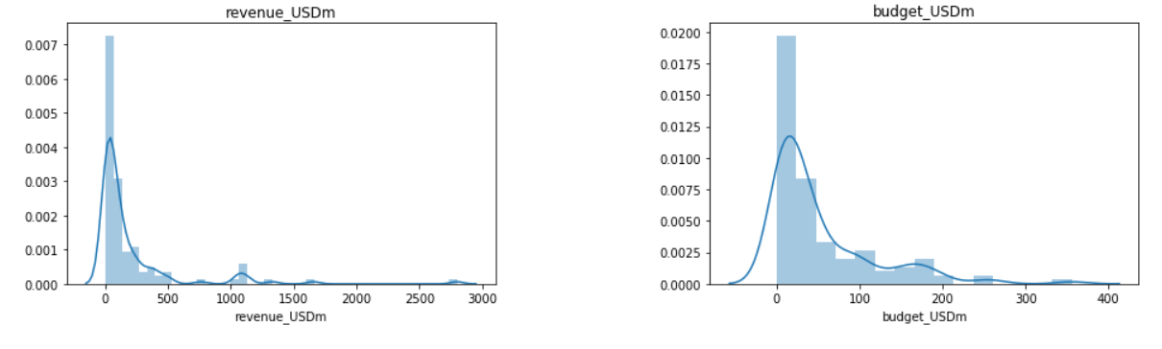
Revenue and budget distribution

